Slide 1

Case study
Exploratory data Analysis on bank loan data

Slide 2
Objective
Analyzing customer risk profile prior to loan approval using exploratory data analysis on previous defaulter's data.
Data preparation
The data set provided was having loan information of 307510 customers.

Slide 3
The application dataset consist of 122 different details related to the loan a customer availed. Out of these there are close to 50 columns with more than 30% null values . The analysis will not be based on the data in these columns.
Analysing the loan amount given to each customer we can see that the mean amount given 27,108 whereas the max amount is 2,58,025 implementing the presence is outliers. Imputing the outliers with the mean is suggested.
Organisation type have 18% null values ie they do not fall under the 58 unique business types recognised by the bank. Since the percentage of null values is small , suggesting to drop them.
Clients age in days, days since changing phone number, are converted to absolute numbers.

Slide 4
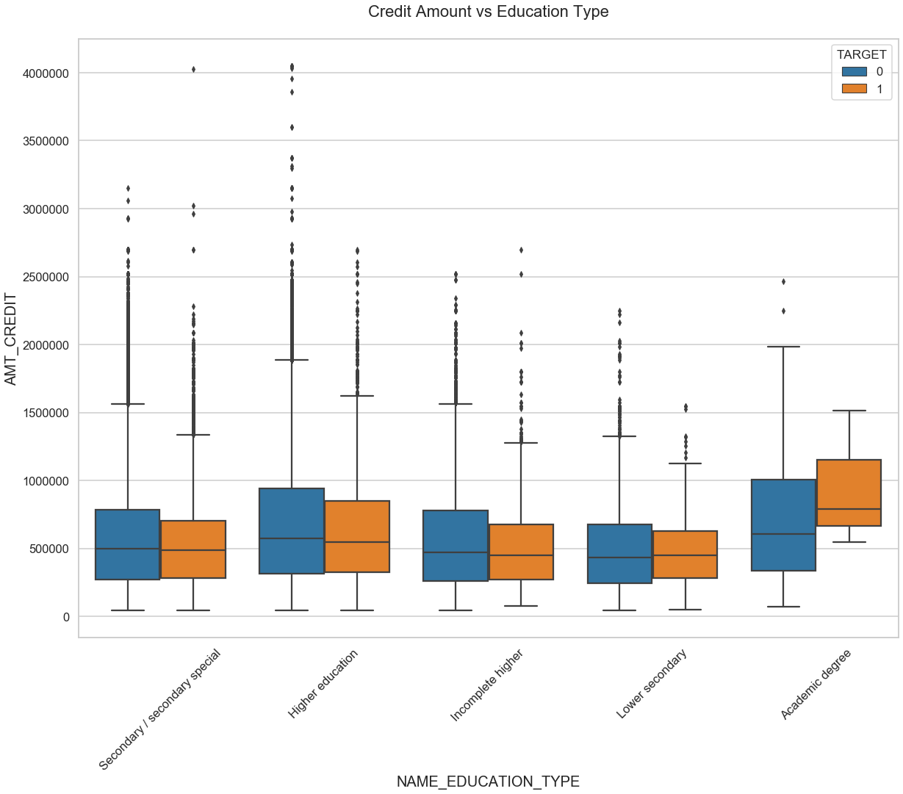
Relationship analysis
1) Credit amount vs Education type
Comparing the graph of education level of defaulters it seems like customers with academic degrees or higher education default higher loan amounts.

Slide 5
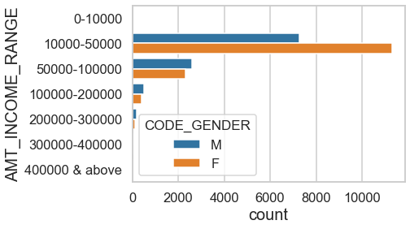
2) Income range of defaulters
Analyzing the income rage of defaulters it was found that female customers in low income groups default more. This gender gap seems to decrease in higher income groups.

Slide 6
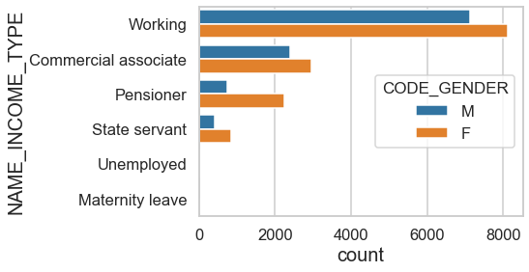
3) Income type and defaulters
State employees tend to payback the loan amount compared to commercial associates.

Slide 7
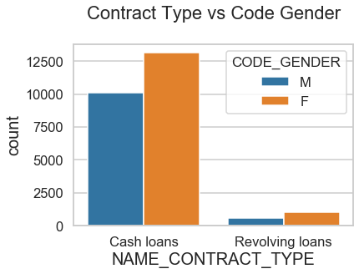
4) Loans per gender
Customers prefer cash loans over revolving loans and hence defaulters are higher in cash loan customers.
Among them female customers have higher default count.

Slide 8
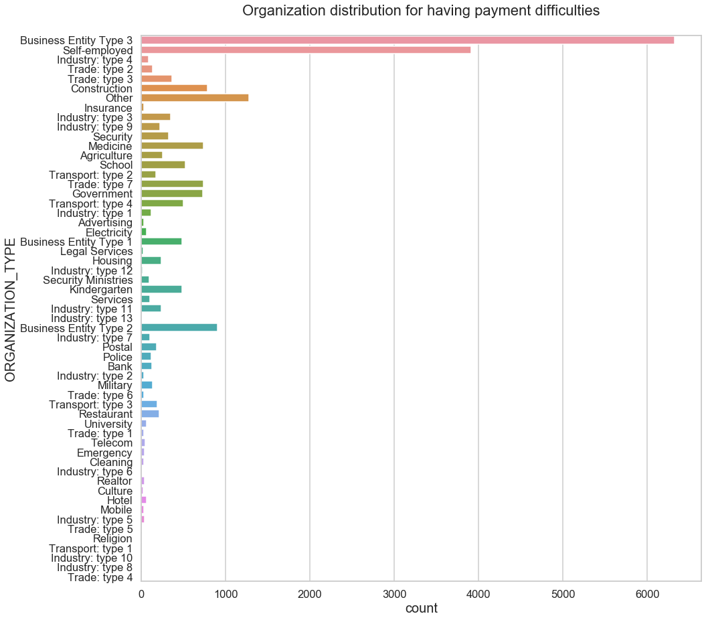
5) organization distribution for defaulters
Customers in organization type as 'Business Entity Type 3' have applied maximum number for credits.
Customer in organization type as 'Industry : type 5' have applied for least number of credits

Slide 9
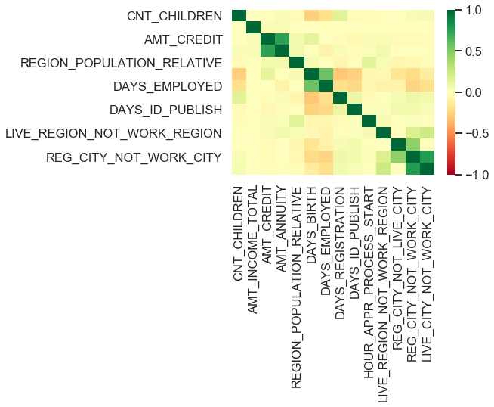
6) Analyzing heatmap map of the columns it was found that
a) loan amount is inversely proportional to the number of children
b)loan amount is positive co related to the Total income
c)loan amount is positive co related to the Density of the population

Slide 10
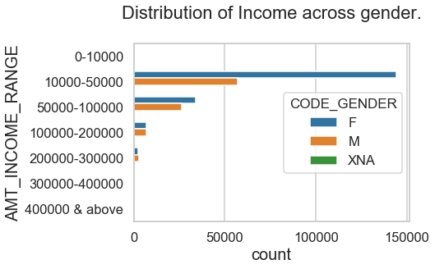
7) Distribution of income across gender.
1) Females applied for more number of loans than Males.
2) Most of the Customers who applied for the loans are in the income range from '10000 - 50000’
3) Count of Customers who applied for the loans in the income range from '200000 - 300000' are least.
4) As the income range increases number of loans applied by Females decreases and there is not count of females after income range 300000

Slide 11
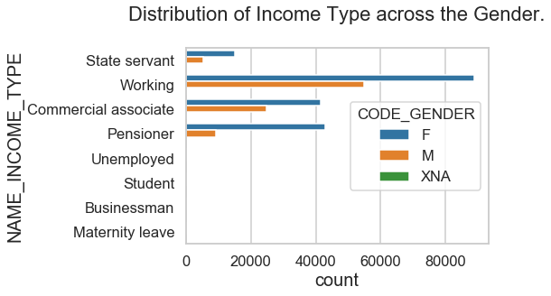
8) Distribution of income type across gender.
Gap between working men and women applying for loan are more across all income types

Slide 12
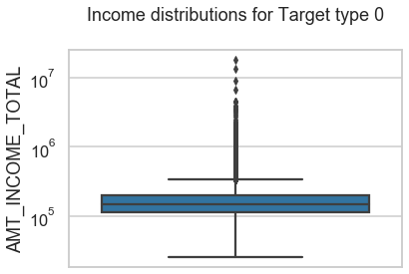
Univariate analysis
Checking outliers for total income column
1.As we can see there are outliers in income total. 2.Income amount is mostly segregated in third quartile.

Slide 13
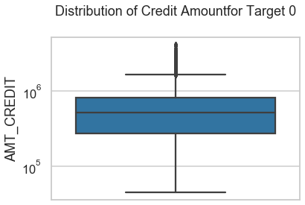
2) Distribution of Credit Amount for non defaulters
1.There are outliers in the amount credited to the client's account.
2.Most of the credit values lies in the first quartile.

Slide 14
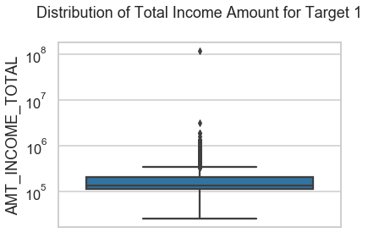
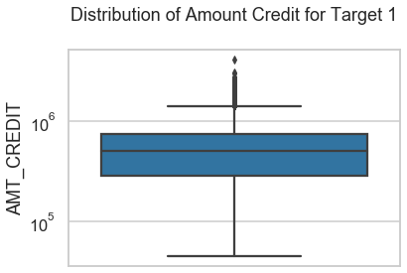
3) Distribution of income in non defaulters
1.Amount Income have some outliers.
2.most of the client's incomes are in the first quartile.ie 25th percentile
4) Distribution of Amount Credit for defaulters
1) Amount credited have some outliers.
2) Most of the creditor's amounts are in third quartile.

Slide 15
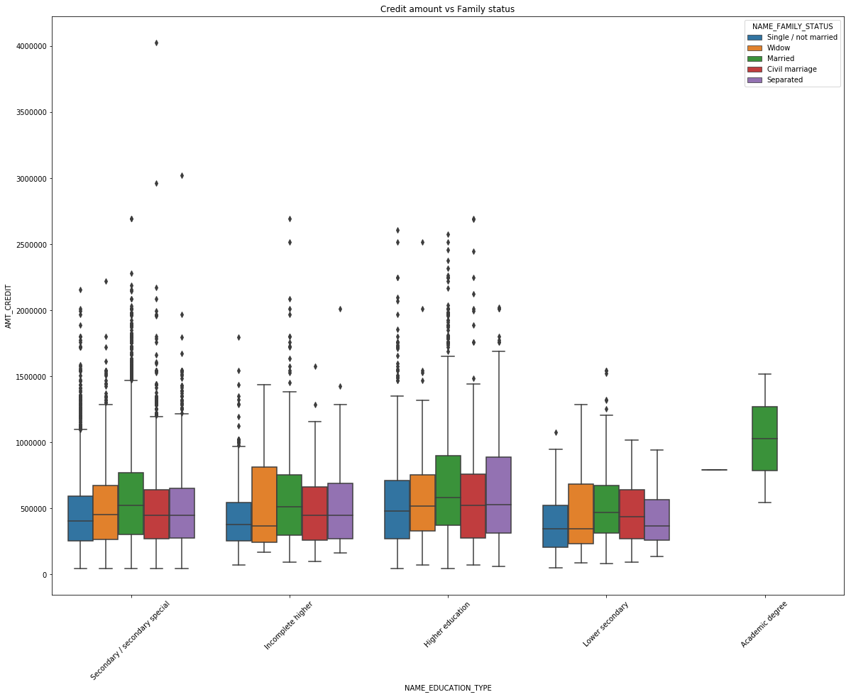
Analyzing customer family status and education level of defaulters
1) Customers having higher degree married or separated are most likely to get more credits.
2) Married secondary and marries higher education have higher number of outliers.
3) Customers having lower secondary degree and separated have lowest number of credits.

Slide 16
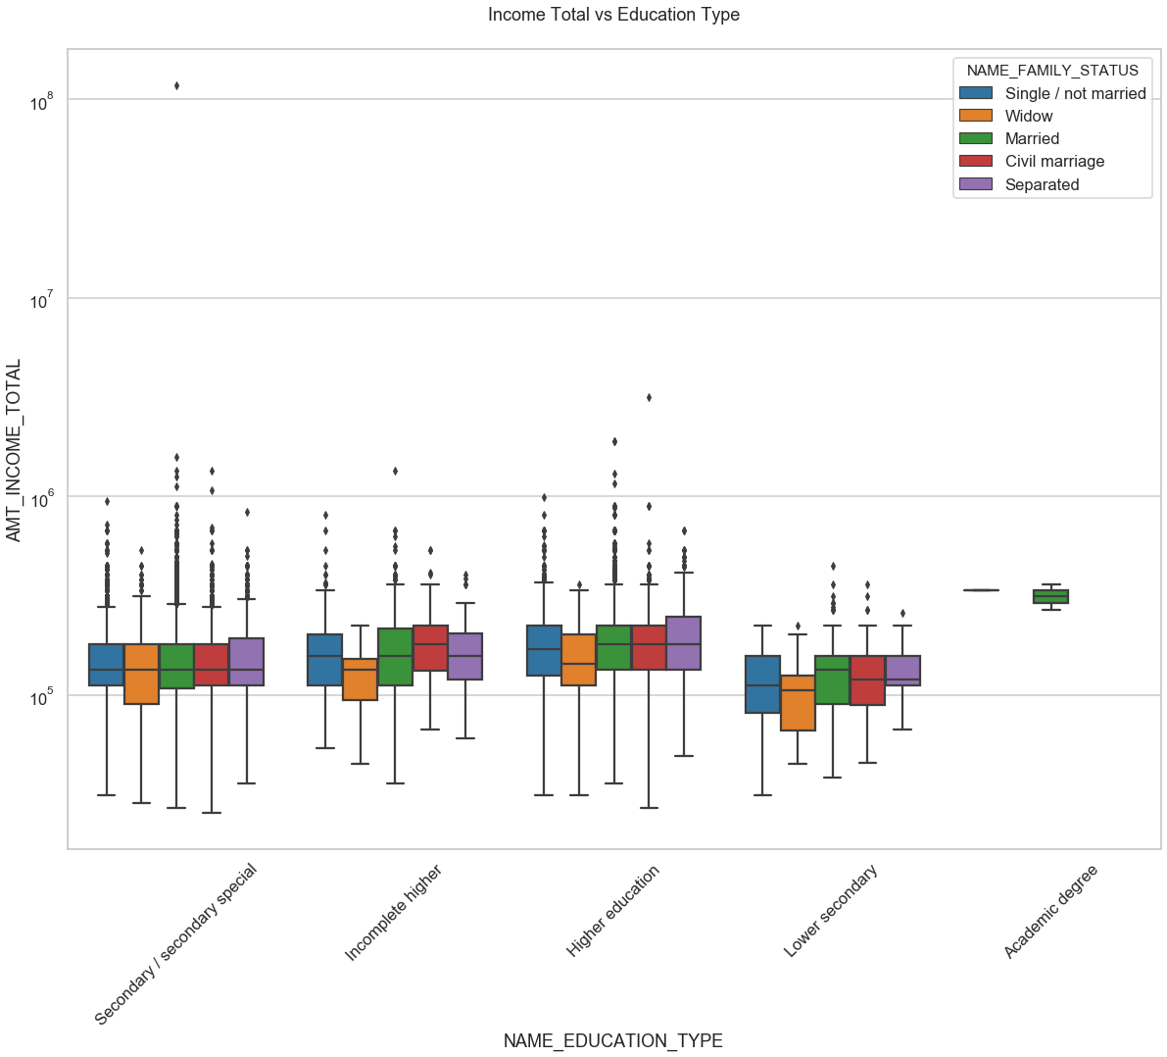
Analyzing total income and education status of defaulters
1)Customers with higher educations have relatively higher income irrespective to their family status.
2)Customers with lower secondary have relatively lower income irrespective to their family status.
3)Higher education customer have larger number of outliers.
4)From both the graph above customers with academic degree have higher degree but have higher income also.
5)Annual Income for Higher Education customers are relatively similar.

Slide 17
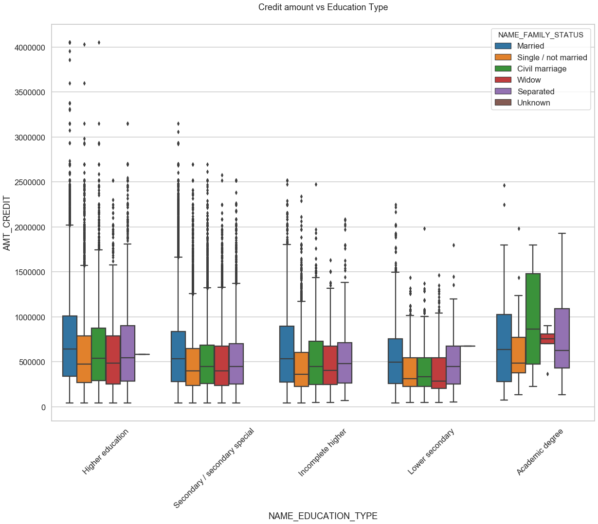
Analyzing customer family status and education level of non defaulters
1) Customers with higher education have higher numbers of outliers.
2) Customers with academic degree and civil marriage have higher number of credits.

Slide 18
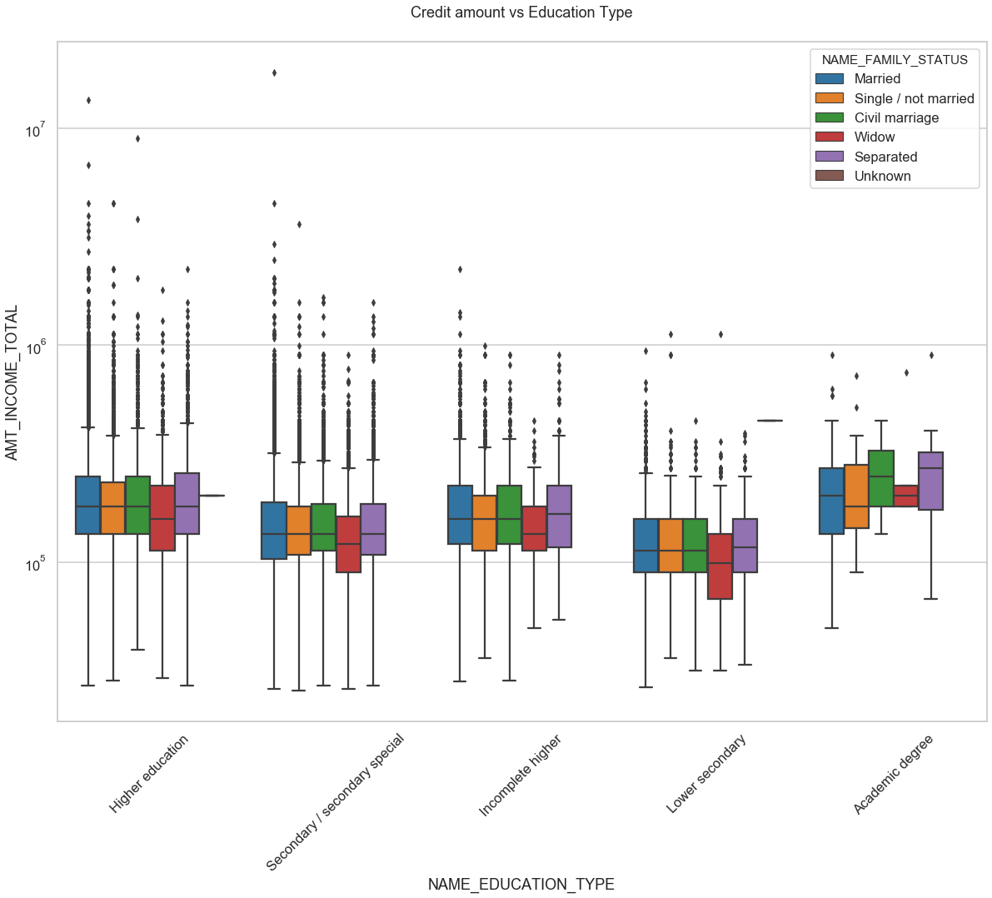
Analyzing total income and education status of non defaulters
1) There are outliers exists for all the family status.
2) Customers having academic degree have higher income range also have higher credit .

Slide 19
Analyzing previous loan application data set
While analyzing previous loan data it was found to have less percentage of null values compared to the application data.
Columns like AMT_ANNUAITY are subject to whether loan gets approved or not hence null values in it is also a value and we can’t drop it. Similar is the case for column CNT_PAYMENT
Column NAME_CASH_LOAN_PURPOSE have values not required for the analysis and will not be considered.

Slide 20
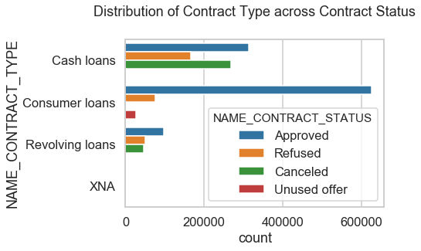
Univariate analysis of previous application dataset
Distribution of Contract Type across Contract Status
Cash loans are refused by company the most.
Consumer loans gets approved most and refused by client least

Slide 21
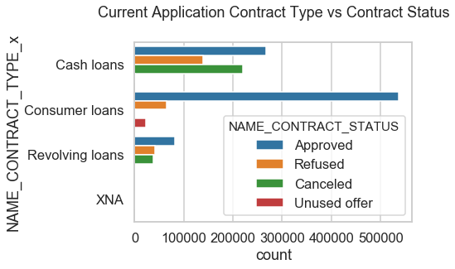
2) Current Application Contract Type vs Contract Status
1)Cash loans type contracts have maximum cancelled status.
2) Consumer loans gets maximum approval.
3) Consumer loans have negligible or none cancelled loans.

Slide 22
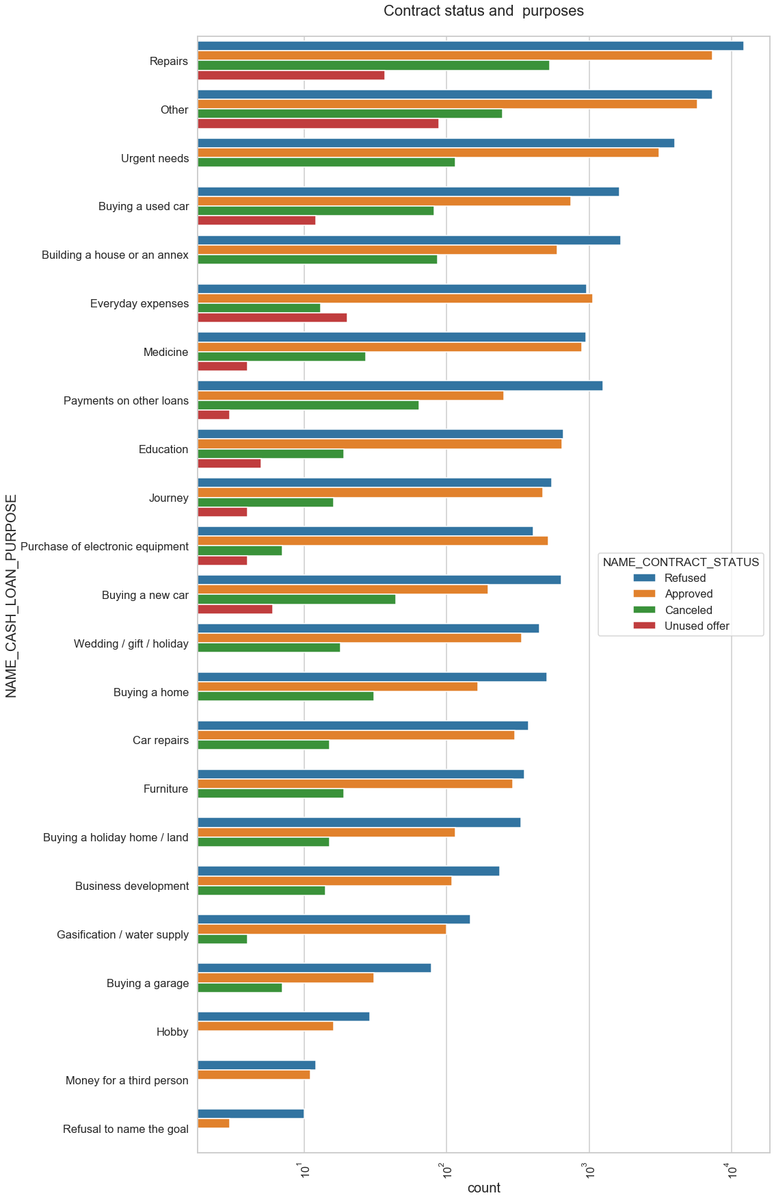
3) Analyzing contact status vs purpose of loan
1)Loans for hobby , money for third person have no cancellation.
2)Loans for Repairs have most number of cancellations.
3)Loans for Education have equal number of Approved and refusal rate.

Slide 23
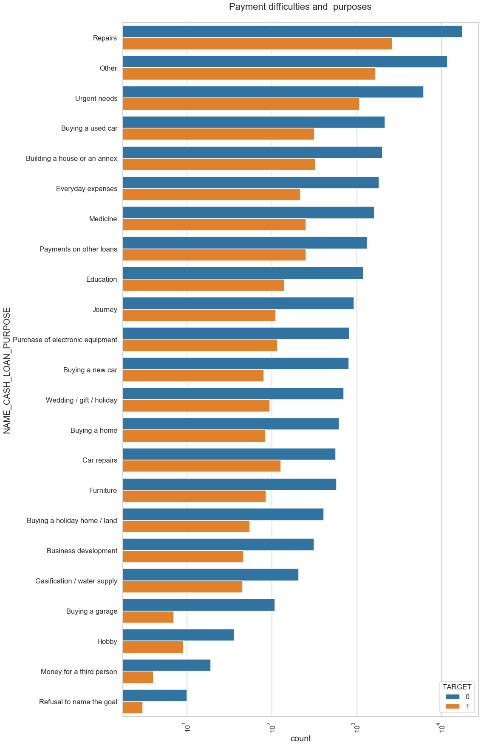
4) Analyzing default rate and purpose
1)Loan taken for repairs have maximum difficulties of payment on time.
2)Loan taken for Hobby, Money for a third person and Buying a garage have comparatively less difficulties than other purpose.

Slide 24
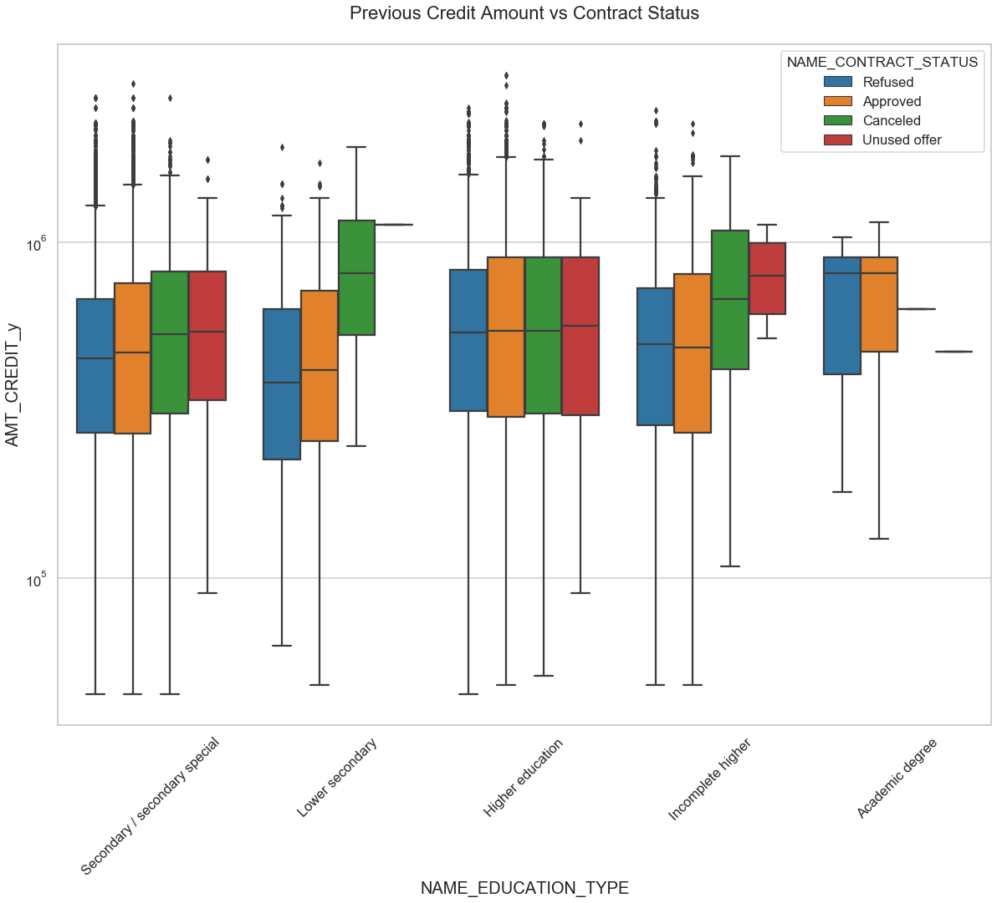
Bivariate analysis of previous data set
1) Analyzing Previous Credit Amount vs Contract Status
1)Contract status as approved for Academic degree have large number of credit amount.
2)For education status as Incomplete higher and Secondary special distribution is almost equal across the contract status.
3)There are outliers for present for the education type.

Slide 25
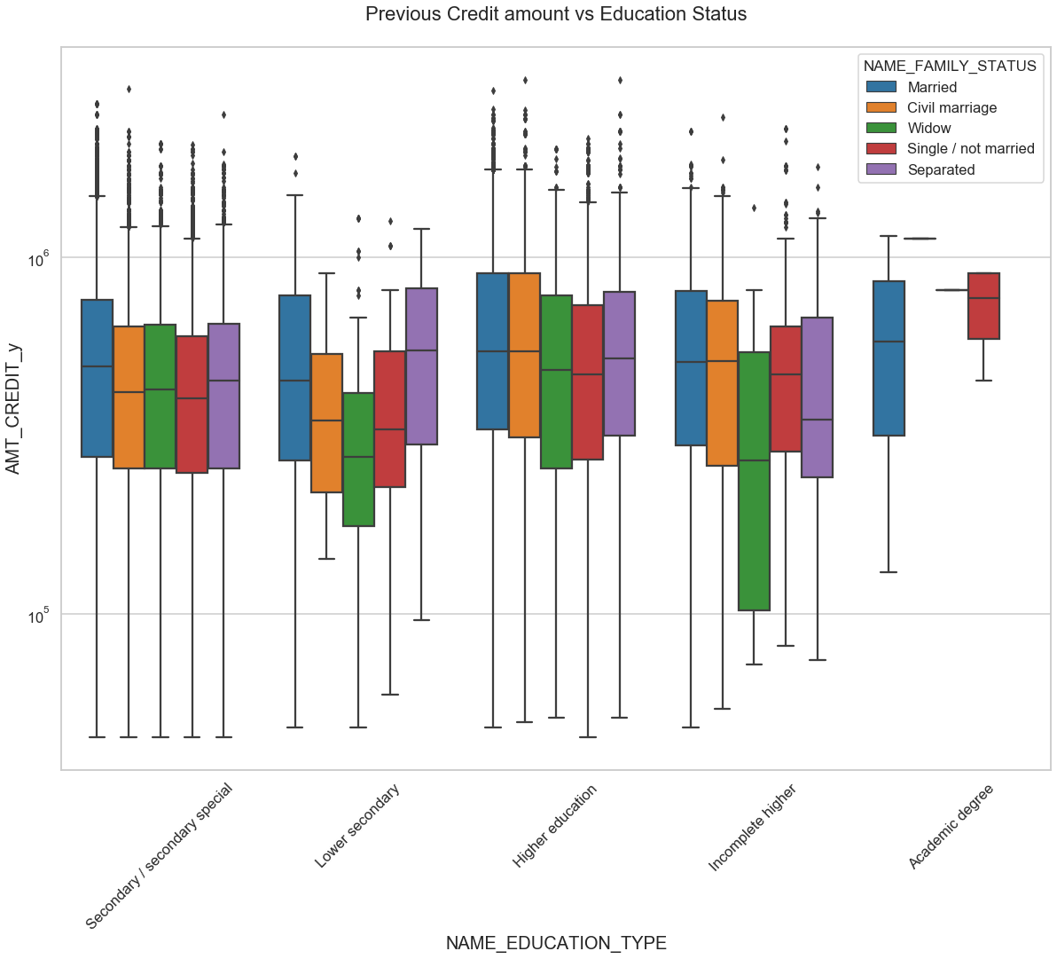
Analyzing Previous Credit Amount vs education status
a)Clients with academic degree got higher previous credits except for single family status clients.
b)Clients with lower secondary academic degree have lowest previous credits for family status for civil marriage, single and widow..

Slide 26
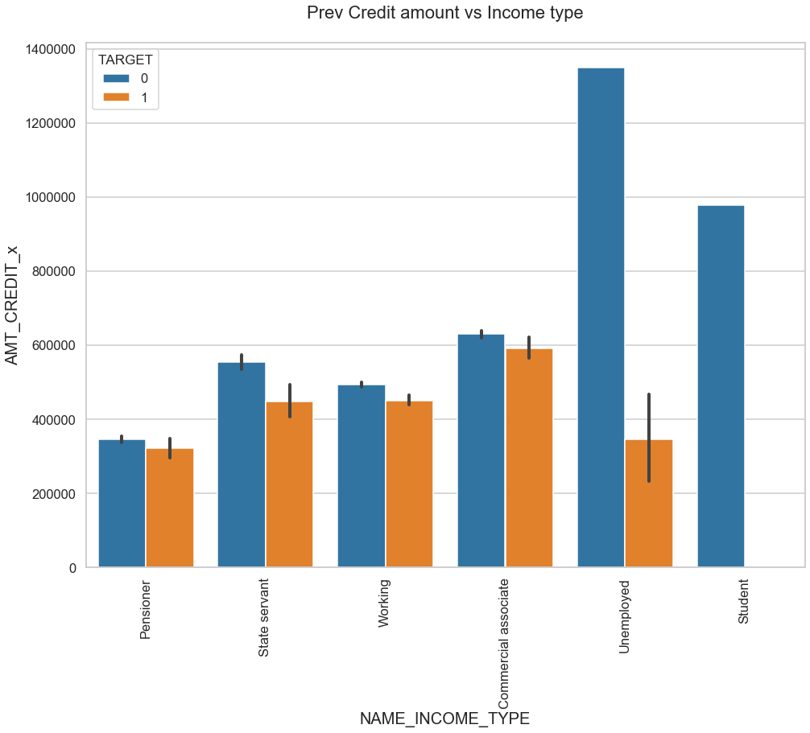
Analyzing Previous Credit Amount vs income type
a)Unemployed customers have comparatively lower default rate than pensioners
b) A high number of loans are left unsolicited by students

Slide 27
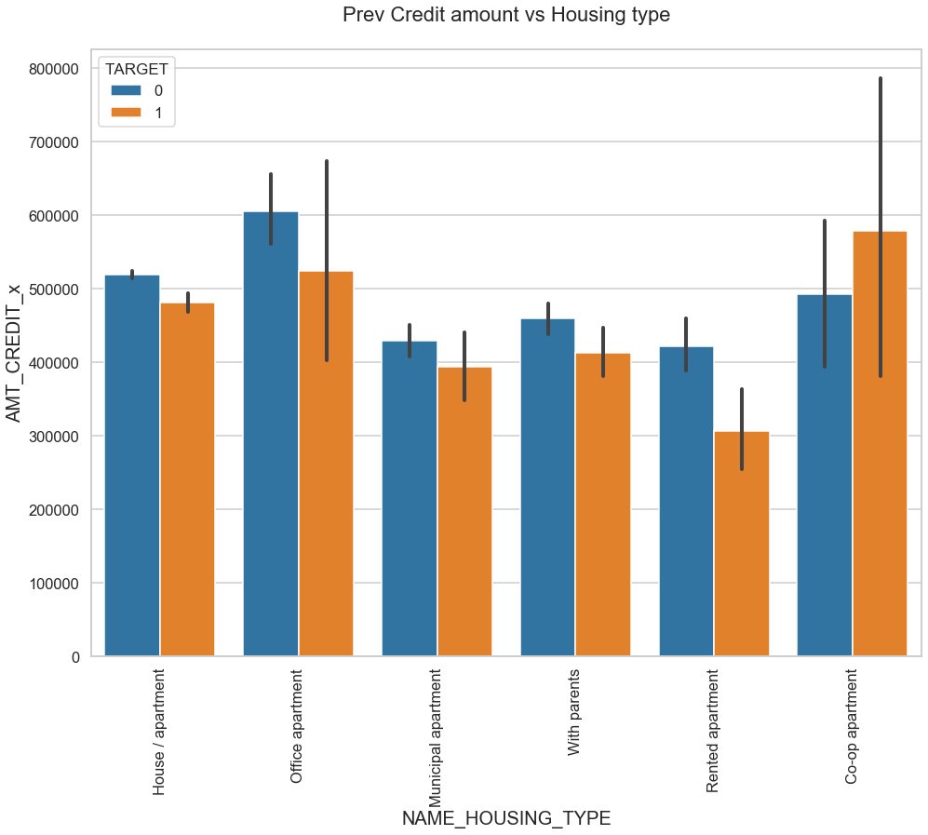
Analyzing Previous Credit Amount vs housing type
a)Client living in office apartment, co-op apartment and with parents have difficulties to pay back the payment.
b)Client living in municipal apartment and rented apartment makes payments on time without failing.

Slide 28
Conclusion
To sum up the analysis
Loan given for 'Repair' have high default rate
Clients living in municipal apartment and with parents are unlikely to default
Income type as students should be given more loans as there is no difficulties of payment of loans.
Bank needs to tighten the cash loan availability.

